Slide 1
THE EVOLUTIONARY CASE FOR
OPEN ACCESS
Council on East Asian Libraries
Association for Asian Studies
20 March 2013
Brian E. C. Schottlaender The Audrey Geisel University Librarian
UC San Diego

Slide 2
Issues in Scholarly Communication
Knowledge output is increasing
Market is economically unsustainable
library budgets tapped out
sales are flattening
Access is decreasing

Slide 3
Open Access …
“This kind of free and unrestricted online availability, which we will call open access … By open access, we mean its free availability on the public internet, permitting any users to read, download, copy, distribute, print, search or link to the full text of these articles, crawl them for indexing, pass them as data to software or use them for any other lawful purpose …”
— The Budapest Open Access Initiative
Digital
Online
Free of charge
Free of most copyright and licensing restrictions
— Peter Suber

Slide 4
Two Primary Vehicles . . .
. . . for accomplishing Open Access
to scholarship:
Open Access Journals
Open Access Repositories

Slide 5
“Evolution”
Growth
Process of continuous change from a lower, simpler, or worse state to a higher, more complex, or better state
Theory that the various types of animals and plants have their origin in other preexisting types and that distinguishable differences between the types are due to modifications in successive generations
Process in which the whole universe is a progression of interrelated phenomena
— Merriam Webster

Slide 6
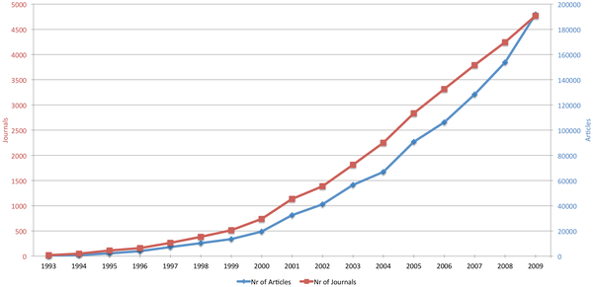
Development of OA Publishing: 1993‒2009
Mikael Laakso, Welling P, Bukvova H, Nyman L, et al. (2011) The Development of Open Access Journal Publishing from 1993 to 2009. PLoS ONE 6(6): e20961. doi:10.1371/journal.pone.0020961 http://www.plosone.org/article/info:doi/10.1371/journal.pone.0020961
Notes:
Very rapid growth of OA publishing during the period 1993–2009. Since the year 2000, the average annual growth rate has been 18% for the number of journals and 30% for the number of articles. This can be contrasted to the reported 3.5% yearly volume increase in journal publishing in general. In 2009 the share of articles in OA journals, of all peer reviewed journal articles, reached 7.7%.

Slide 7
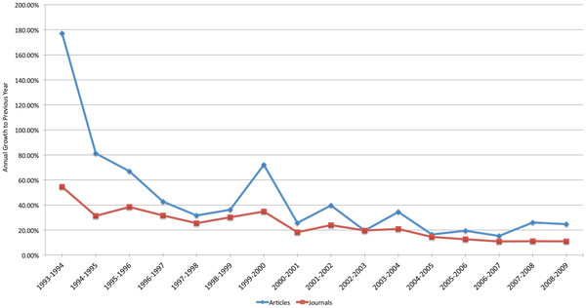
Three Major Phases of OA Publishing
The Pioneering Years
The Innovation Years
The Consolidation Years
—Mikael Laakso et al.
Notes:
Division into three distinct periods is suggested: The Pioneering years (1993–1999), the Innovation years (2000–2004), and the Consolidation years (2005–2009).

Slide 8
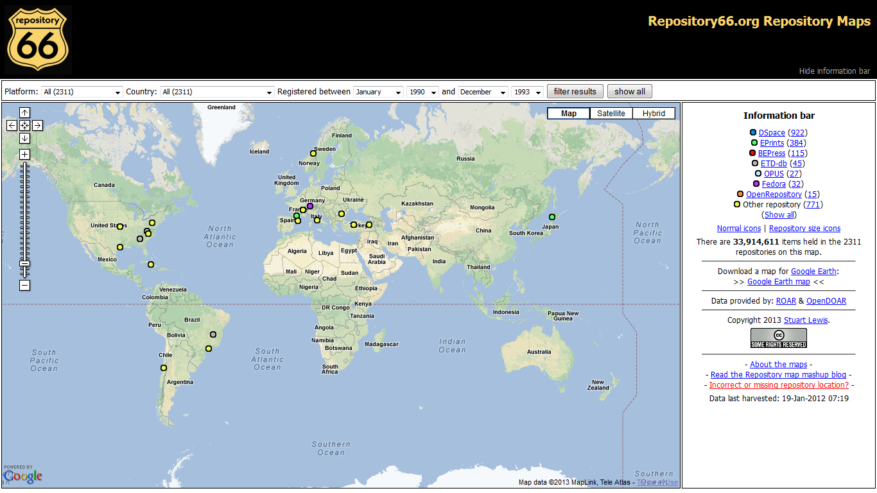
Development of OA Repositories: 1993

Slide 9
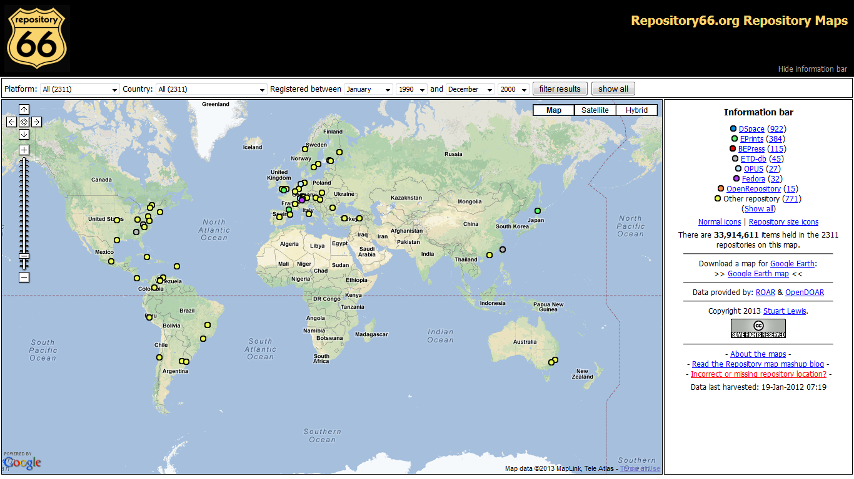
Development of OA Repositories: 2000

Slide 10
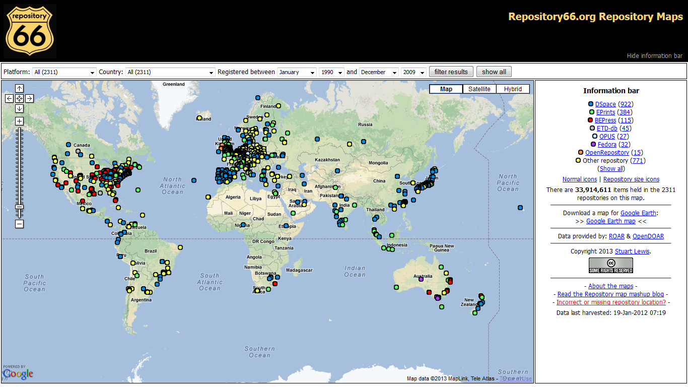
Development of OA Repositories: 2009

Slide 11
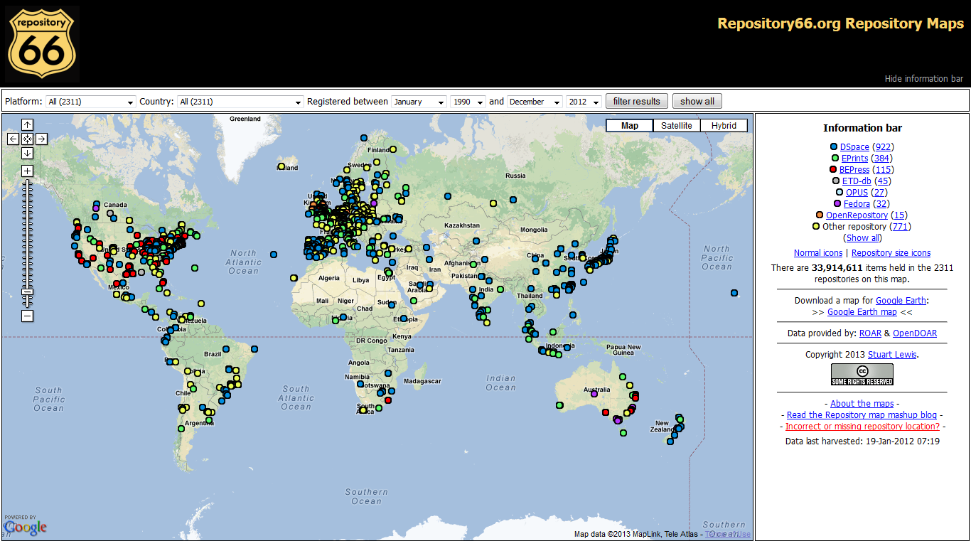
Development of OA Repositories: 2012

Slide 12
Open Access
Journals:
1993: 20
2000: 740
2009: 4,800
2011: 6.700
Articles:
1993: 240
2000: 35, 500
2009: 192,000
2011: 340,000
Repositories
1993: 20
2013 2,311
— Mikael Laakso et al.
— Biomed Central

Slide 13
“Ecosystem” =
The complex of a community of organisms and its environment
—Merriam Webster
Complex of living organisms, their physical environment, and all their interrelationships
—Concise Encyclopedia

Slide 14
Three Major Phases of OA Publishing
The Pioneering Years
The Innovation Years
The Consolidation Years
—Mikael Laakso et al.
Notes:
Division into three distinct periods is suggested: The Pioneering years (1993–1999), the Innovation years (2000–2004), and the Consolidation years (2005–2009).

Slide 15
Intellectual and Policy Developments
2000: The Tempe Principles [… for Emerging Systems of
Scholarly Publishing]
2002: The Budapest Open Access Initiative
2003: The Bethesda Statement [on Open Access Publishing]
2003: The Berlin Declaration [… on Open Access to Knowledge
in the Sciences and Humanities]
2003: NIH Data Sharing Policy
2005: Wellcome Trust Open Access Mandate
2005: NIH Public Access Policy
2006: FRPAA (Federal Research Public Access Act)
2007: MIT Open Courseware Initiative
2008: Harvard Initiatives for Open Access to the Scholarly Literature
2011: NSF Data Management Mandate
2011: Rome Declaration [… on Current Research Information Systems
and Open Access Repositories]
2012: The Denton Declaration [… An Open Data Manifesto]
2013: OSTP Directive

Slide 16
Infrastructure and Venue Developments
1980s: Postmodern Culture, Psycholoquy, etc.
1991: arXiv
1997: SPARC (Scholarly Publishing and
Academic Resources Coalition)
1998: PKP (Public Knowledge Project)
1999: PubMed Central
1999: OAI (Open Archives Initiative)
2000: BioMed Central
2001: PLoS (Public Library of Science)
2008: FP7 (European Commission Open Access Pilot
in the Seventh Framework Programme )
2009: COAR (Confederation of Open Access Repositories)
2010: OpenAIRE (Open Access Infrastructure for
Research in Europe)
2012: eLife

Slide 17
Section Title Goes Here
— askabiologist.asu.edu

Slide 18
Ecosystem
OPEN ACCESS
arXix
SPARC
Budapest Initiative
PubMed Central
PLoS
FRPAA
Berlin Declaration
NIH Public Access Policy
NSF Data Management Mandate
OAI

Slide 19
And So …
Rapid OA Growth
+
Complex OA Relationships
=
OA Evolutionary Inevitability

Slide 20
… Now What?
Other “O”s
Educational resources
Textbooks
Course[ware]
MOOCs
Data
Notes:
No longer are we bound to or by the hegemony of the Journal Impact Factor.

Slide 21
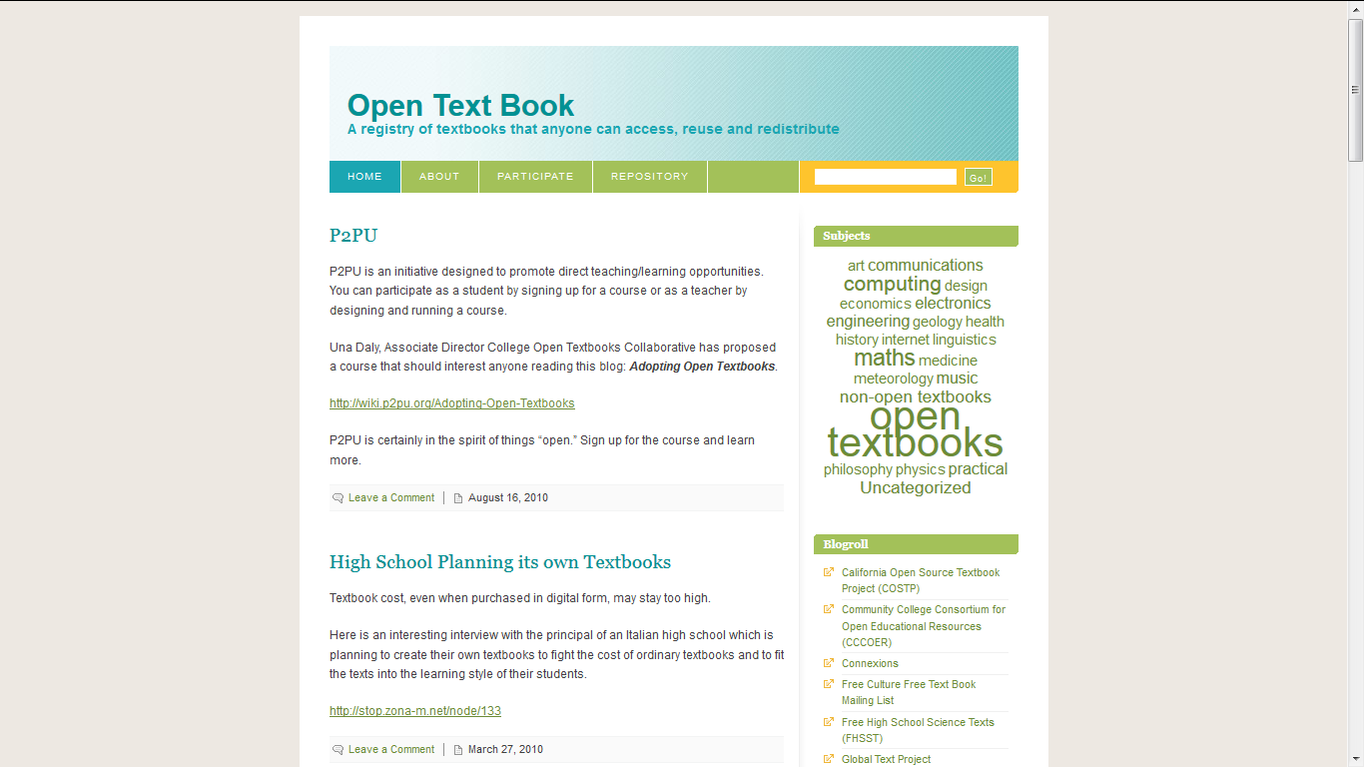
… Now What?
Notes:
No longer are we bound to or by the hegemony of the Journal Impact Factor.

Slide 22
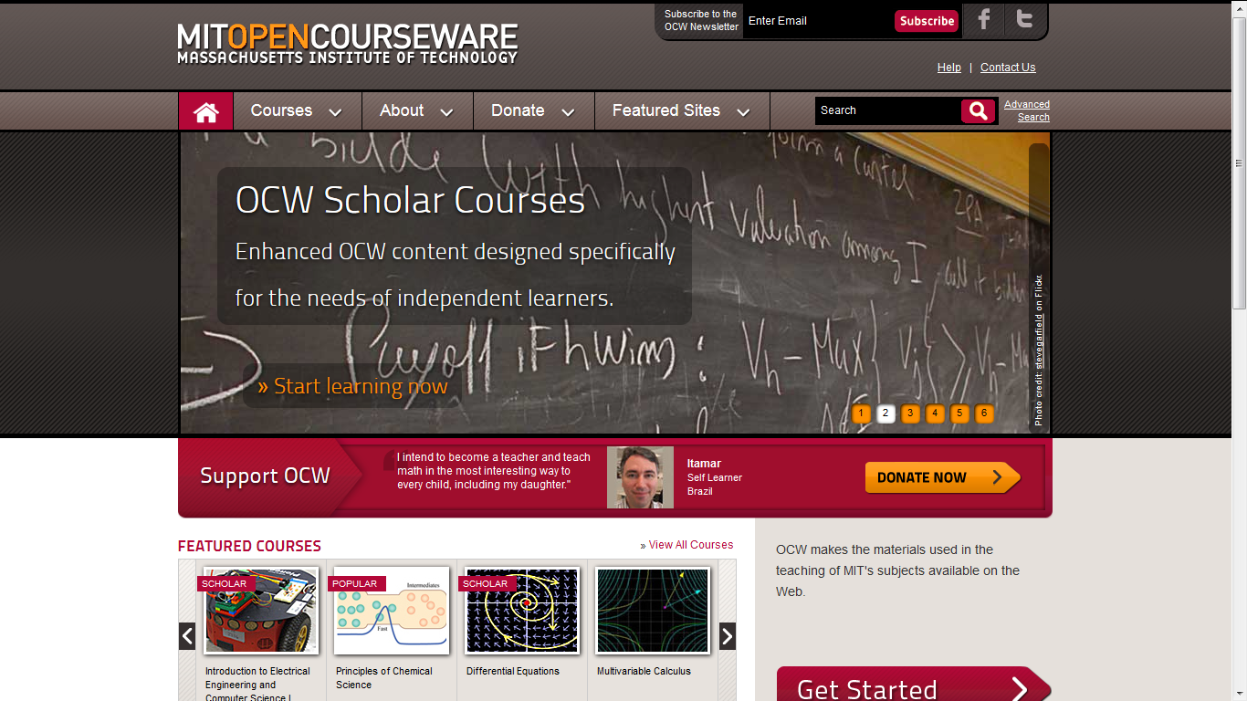
… Now What?
Notes:
No longer are we bound to or by the hegemony of the Journal Impact Factor.

Slide 23
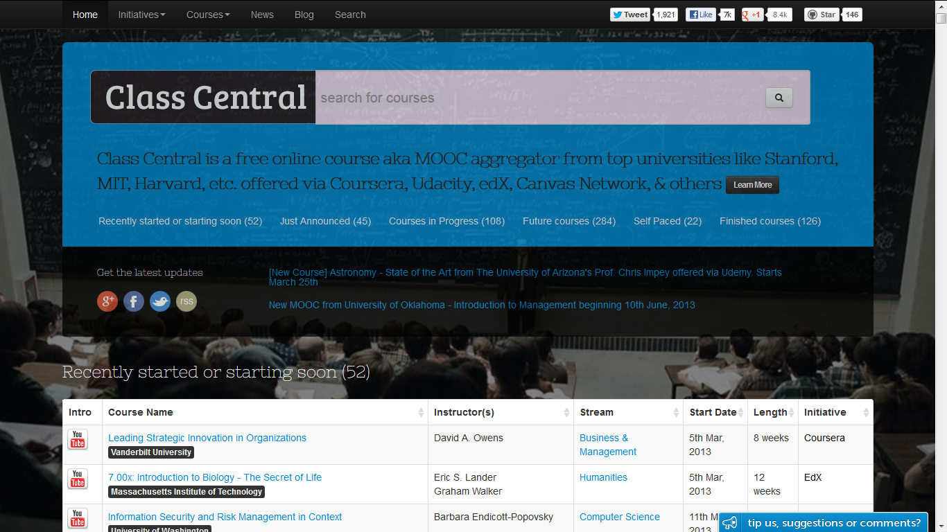
… Now What?
Notes:
No longer are we bound to or by the hegemony of the Journal Impact Factor.

Slide 24
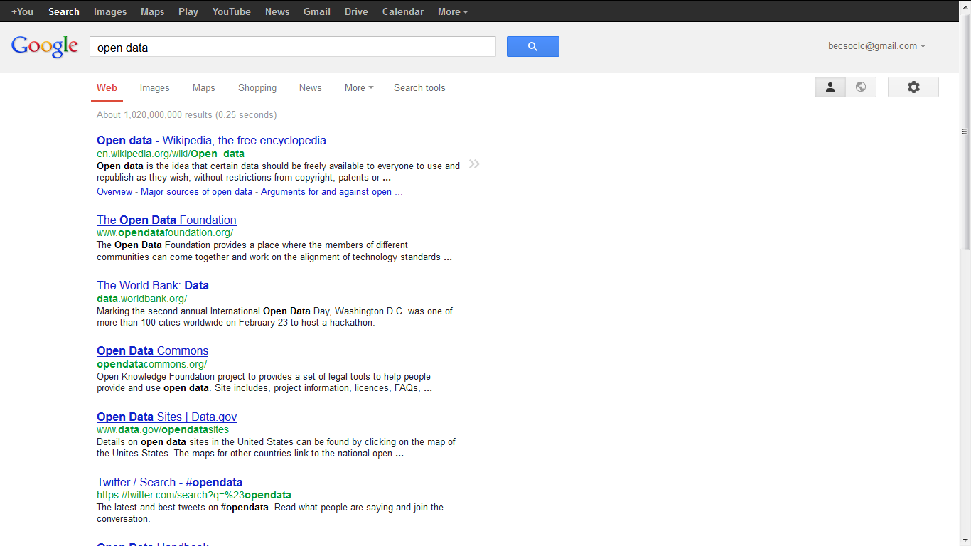
… Now What?
Notes:
No longer are we bound to or by the hegemony of the Journal Impact Factor.

Slide 25
… Now What?
Other “O”s
Educational resources
Textbooks
Course[ware]
MOOCs
Data
Other Metrics
Pageviews
Downloads
Citation counts
Social media references (bookmarks, posts, favorites, tweets)
Repository reports
Notes:
No longer are we bound to or by the hegemony of the Journal Impact Factor.

Slide 26
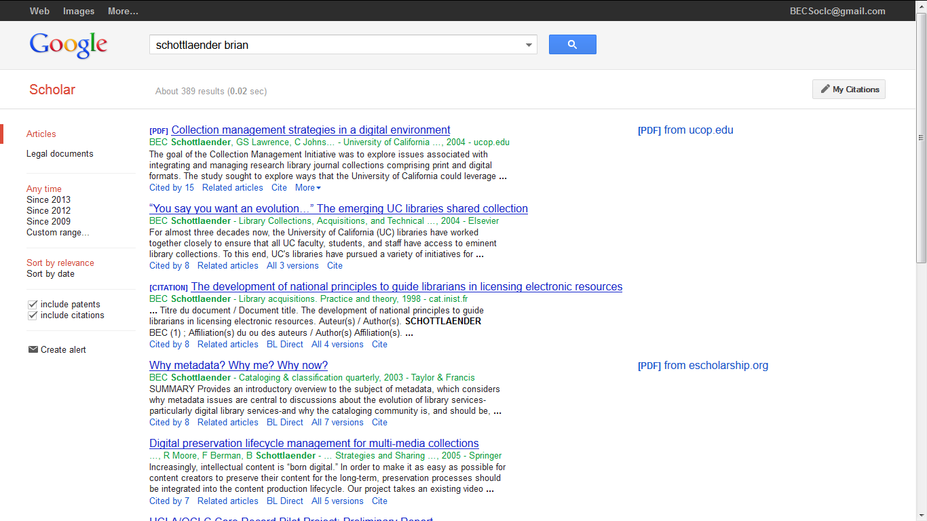
Google Scholar
Notes:
No longer are we bound to or by the hegemony of the Journal Impact Factor.

Slide 27
Google Scholar
Notes:
No longer are we bound to or by the hegemony of the Journal Impact Factor.

Slide 28
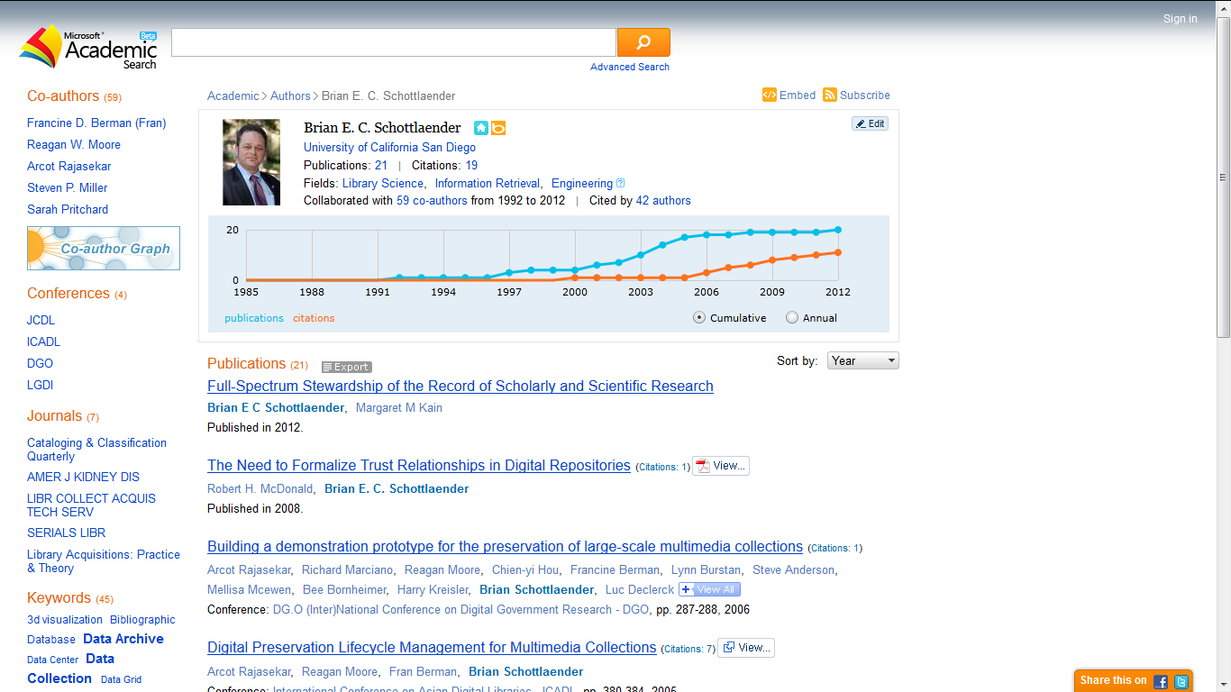
Microsoft Academic Search

Slide 29
Microsoft Academic Search

Slide 30
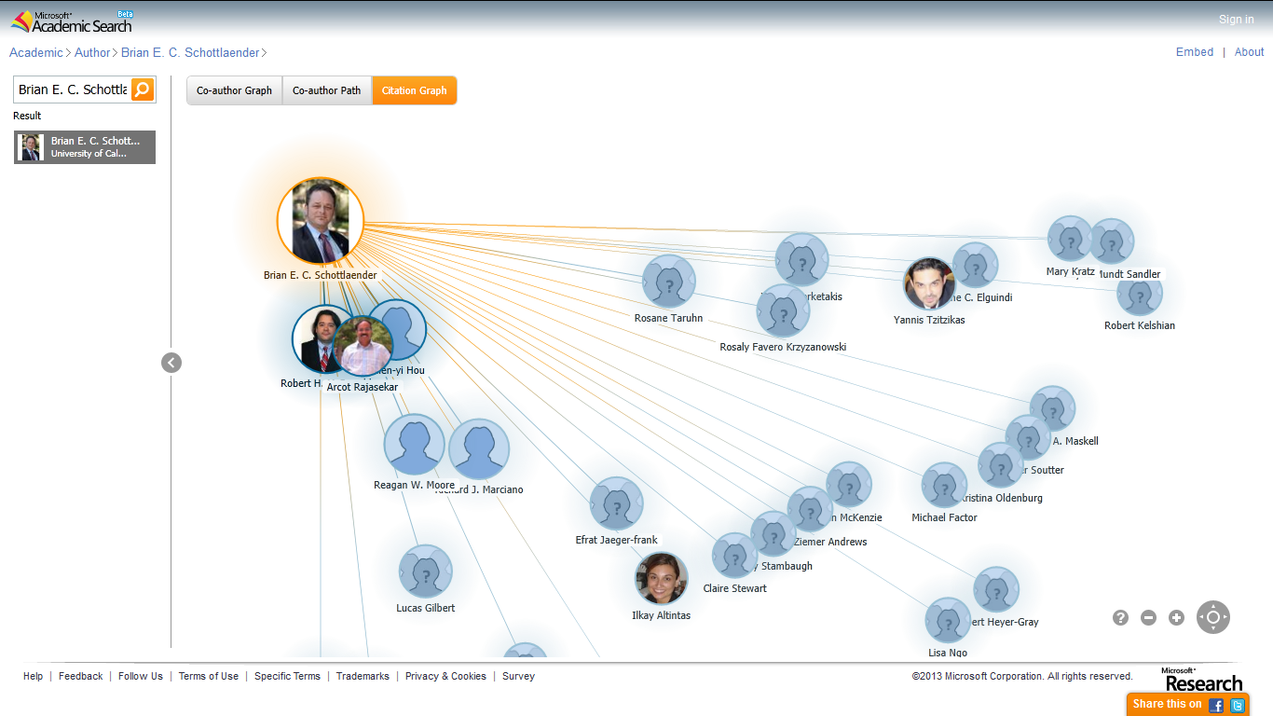
Microsoft Academic Search

Slide 31
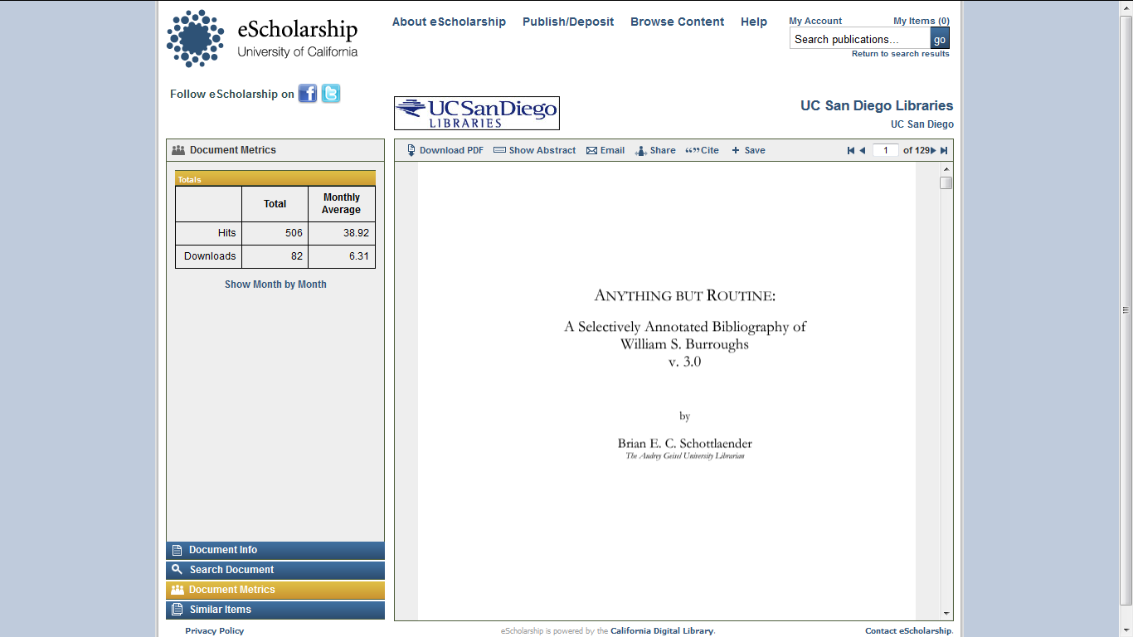
Repository Reports (IN)

Slide 32
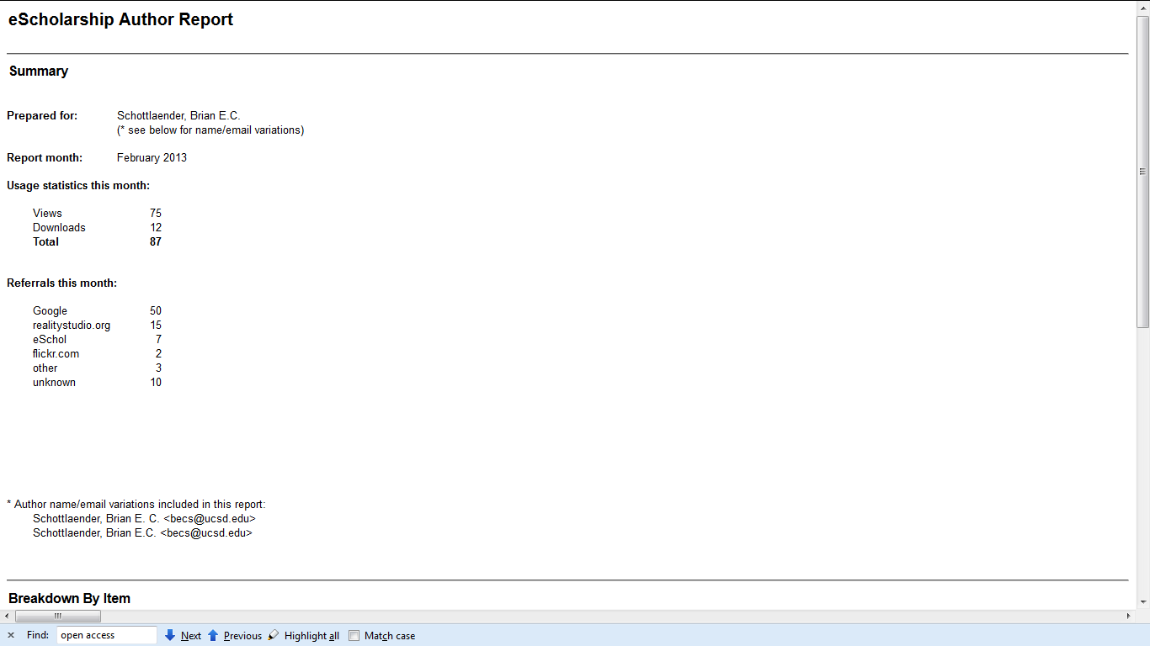
Repository Reports (FROM)
eScholarship Report

Slide 33
THANK YOU
Brian E. C. Schottlaender The Audrey Geisel University Librarian
UC San Diego
BECS@ucsd.edu

